Slide 1
Corporate presentation
Automotive Business Focus
2023

Slide 2
Who are we?
01

Slide 3
Our business
BOND • PROTECT • BEAUTIFY
Our Values
Our Vision
Human Touch
Unite People
Committed to excellence and customer satisfaction
Protect the environment
Accountable
for the future
Beautify the world
Our Mission
Simply applying most efficient solutions

Slide 4
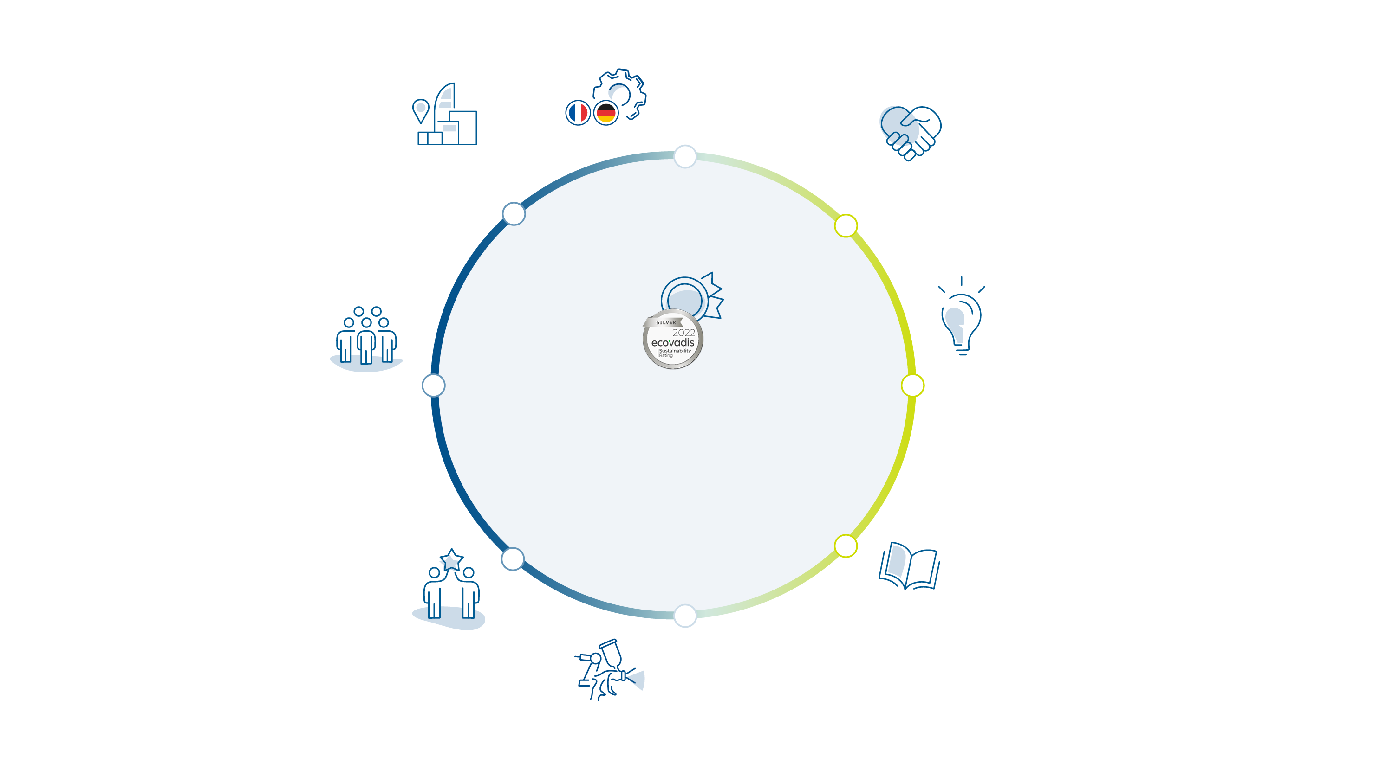
3 production
plants
15 subsidiaries
+200 M€
in revenue
+4%
of revenues invested
in R&D
+ 3000
partners
CSR commitment
ECOVADIS
SILVER LABEL
106
families of active registered patents
+1000
employees
100%
tested products

Slide 5
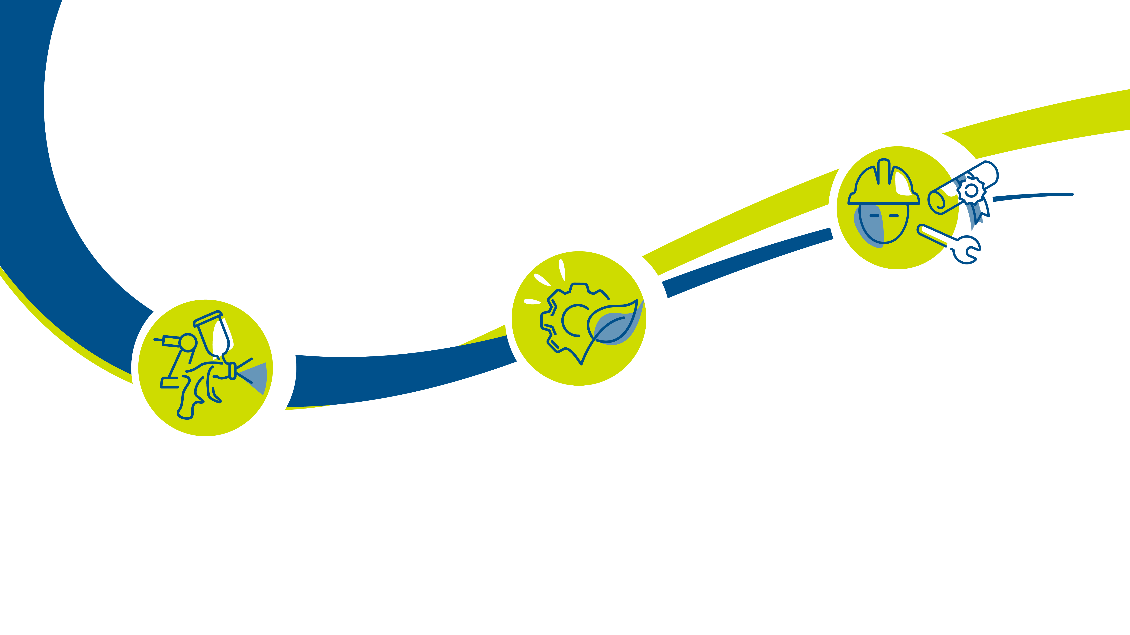
For almost a century, Sames has provided services and equipment for the application of liquid and powder paints, adhesives and sealants to bond, protect and beautify all types of surfaces
Services:
audit, training, installation, consulting, repair and assistance to programming
Innovative solutions:
serving the industrial efficiency of the most demanding customers, and respectful of the environment
Complete solutions:
manual sprayers, automatic and robotic sprayers, pumps and dosing machines

Slide 6
A range of products and services that meet the needs of all application businesses
02

Slide 7
Airspray
Airmix®
Airless
Coating technology that guarantees the highest finish
The perfect mix between finishing quality and productivity
Most productive application technology to protect surfaces
metal
plastic
wood
wood
metal
metal
automotive
consumer
goods
transportation
furnitures
agricultural
aeronautics
infrastructures
transportation
Sealant and adhesives
application solutions
Liquid coating application
solutions for rotary bell atomizer, with and without electrostatic
Powder coating application solutions
metal
metal
plastic
wood
metal
wood
automotive
transportation
consumer
goods
automotive
consumer goods
construction
aeronautics
transportation
infrastructures
consumer
goods

Slide 8
Consulting
Technical
Audit
Consulting
Training
Customer assistance
Technical support / process lab services
Free technical and phone support
Operational performance
Custom-made project
Spare parts
Service contracts
Design and realization of tailor-made solutions and turnkey projects

Slide 9
A recognized expertise
in all markets
Transportation
Wood industry
Construction
equipment
Agricultural
Consumer goods
Construction and metal infrastructures
Automotive

Slide 10
Manual solutions
Automatic and robotic solutions
Pumps
Dosing and mixing systems
Airspray
Airmix®
Airless
Since 1925, the technology application that guarantees the highest finish.
Airmix® creator since 1975, the perfect mix between finishing quality and productivity.
Most productive application technology to protect surfaces.

Slide 11
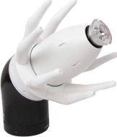
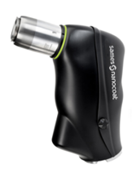
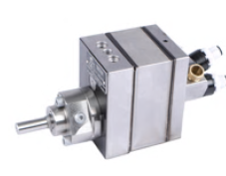
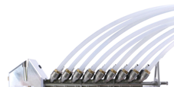
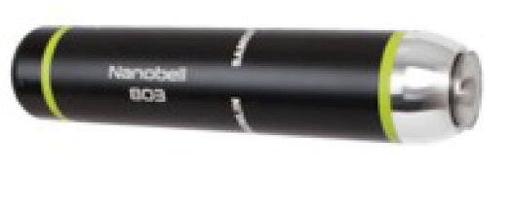
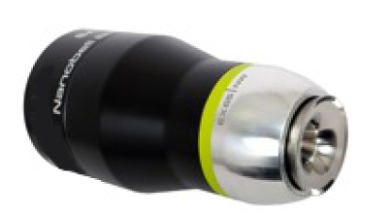
Liquid coating solutions by rotary bell atomizer, with and without
electrostatic since 1946.
Automatic and robotic solutions with gun or rotary bell atomizer
Gear pumps
Quick color change solution

Slide 12
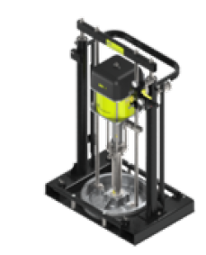
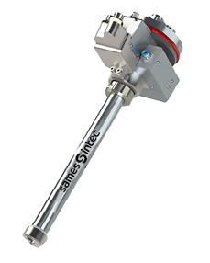
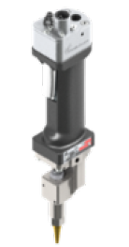
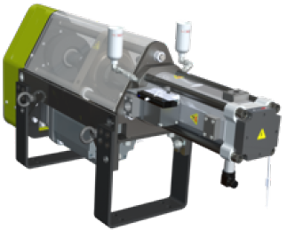
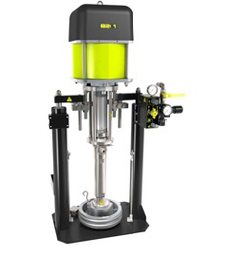
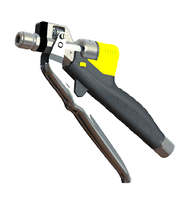
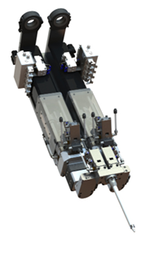
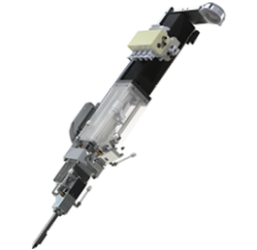
Pumping beyond possible, apply with extreme precision.
Manual dispensing solutions
Automatic dispensing solutions
Robotic dispensing solutions
Pumping and pressure control systems
2K Systems

Slide 13
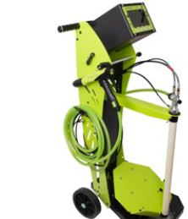
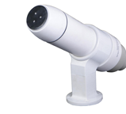
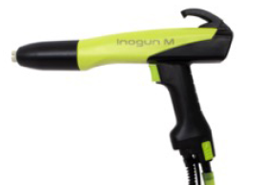
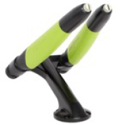
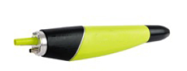
Powder coating solutions since 1960, to meet the highest productivity needs.
Manual solutions
Automatic and robotic solutions with gun or rotary bell atomizer
Control systems
Powder booths

Slide 14
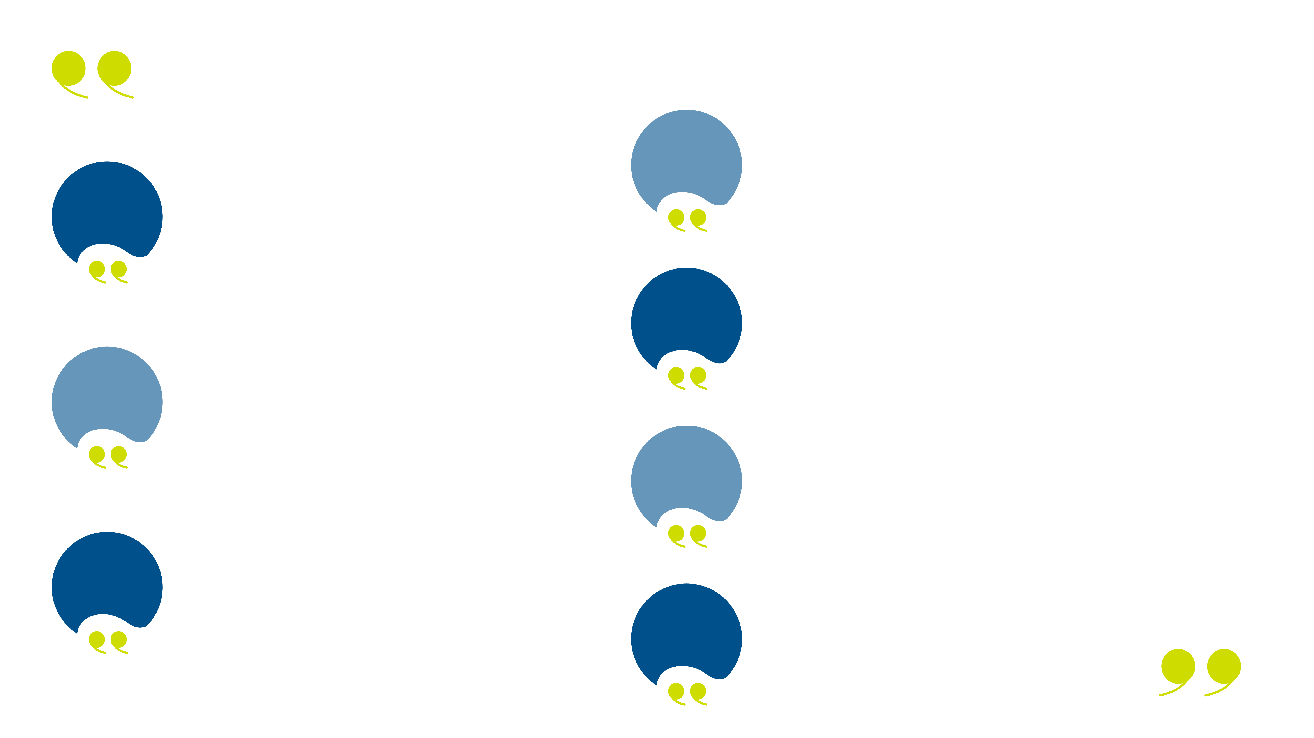
Our commitments
Services teams & equipment to test the efficiency of our solutions, to audit your installations, to train your teams, to maintain your equipment.
4
1
Close to you, skilled Sames teams and a large experienced network of official partners.
5
Efficient and environmentally friendly solutions for your bonding, sealing and painting processes.
Long lasting repairable products, German and French designed, with a 2-year free warranty for most of our equipment.
2
6
Modular solutions that adapt to your needs and your local requirements.
3
Tested parts and products, assembled by hand, using standardized processes.
7
A culture of partnership and a very long term loyalty.

Slide 15
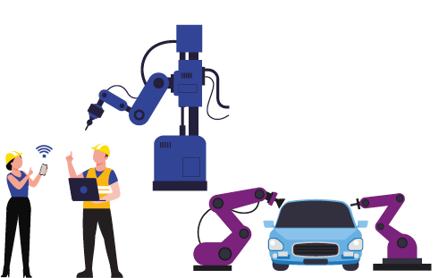
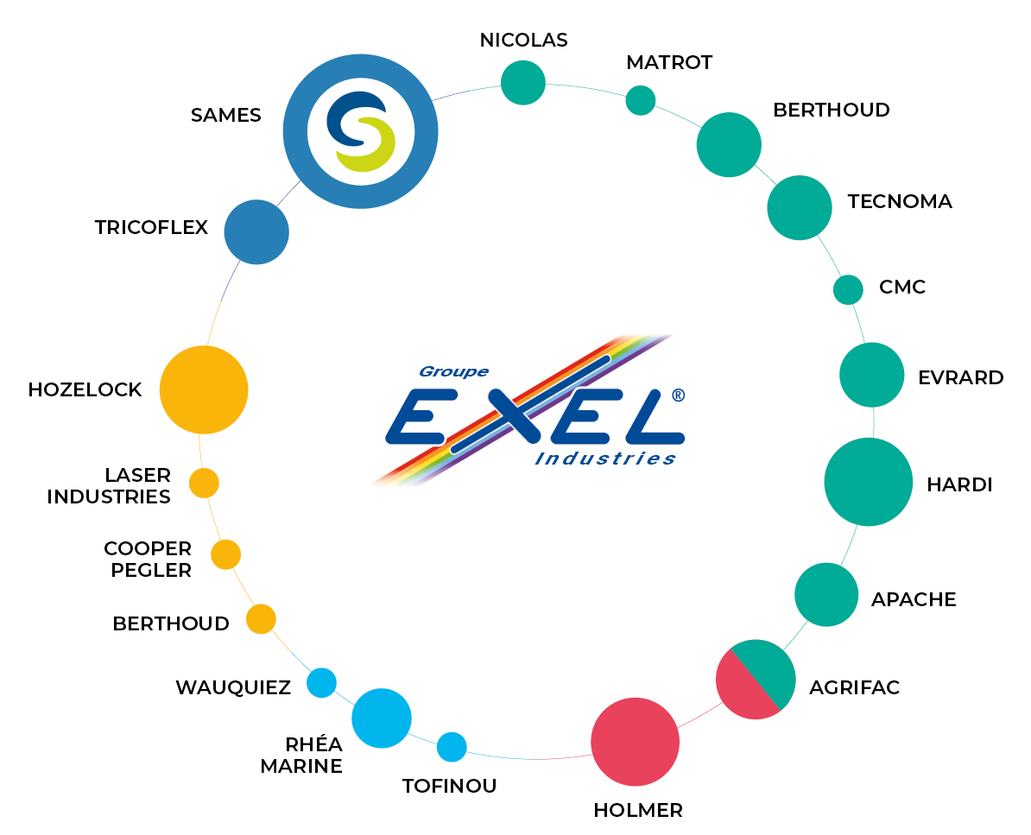
EXEL industry
INDUSTRY
AGRICULTURAL EQUIPMENT
LEISURE

Slide 16
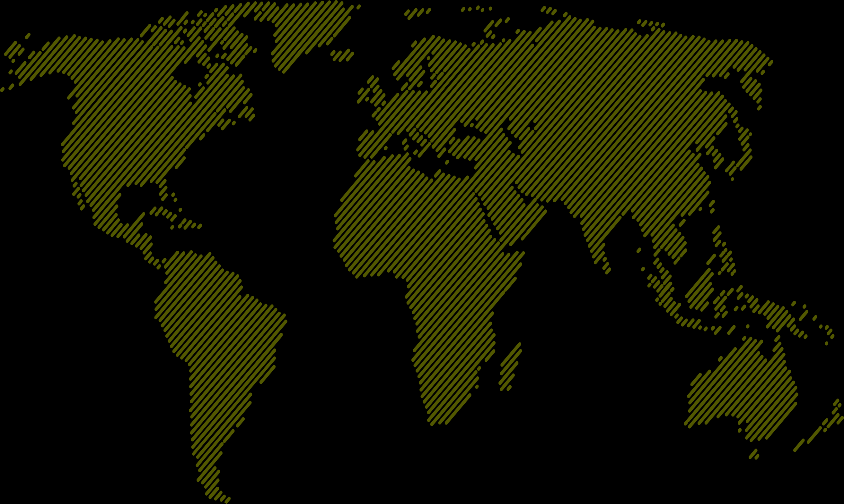
Close to you,
everywhere in the world
Germany
Poland
Canada
Sweden
France
UK
Russia
USA
Latvia
Japan
Czech Republic
Turkey
China
Portugal
Italy
Mexico
India
Thaïland
Vietnam
Malaysia
Philippines
Brazil
Spain
Indonesia
Singapore
Argentina
Headquater
Meylan (F)
Production plants
Meylan (F)
Stains (F)
Erftstadt (D)
Subsidiaries with application lab
Commercial offices

Slide 17
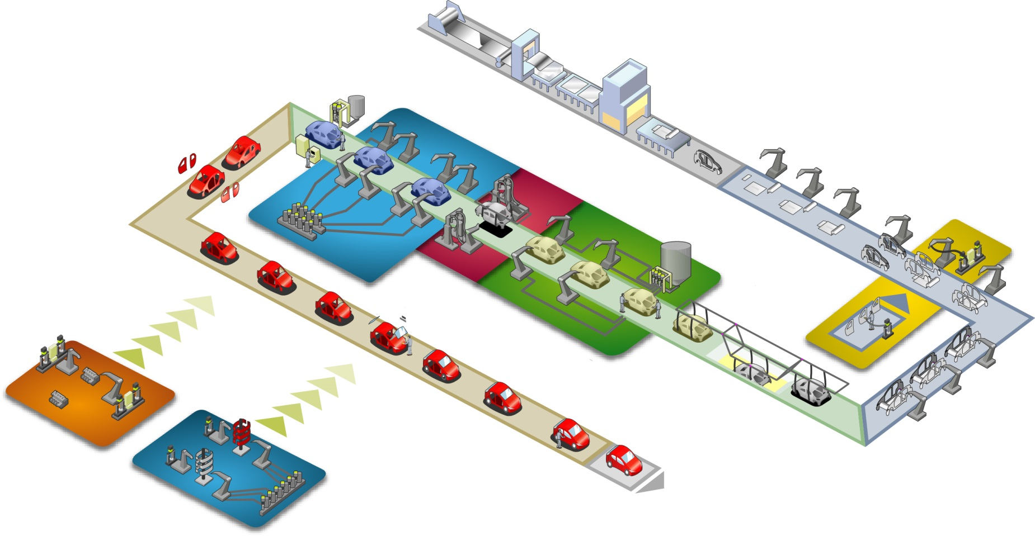
From pumps to application systems We are designers, innovators and manufacturers of process equipment for all shops in your factory
Trimshop
Paintshop
Bodyshop
Powertrain
Tiers 1
Battery
Automotive Paint solutions
RENAULT Revoz
BMW i3 Carbon composite assembly

Slide 18
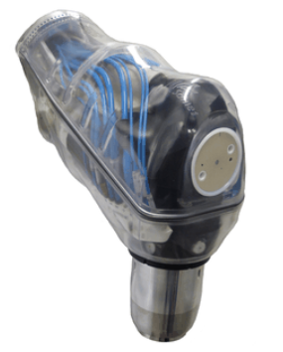
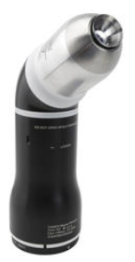
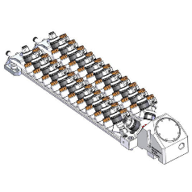
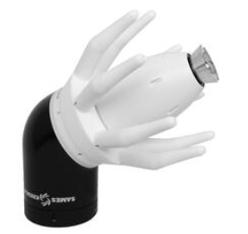
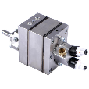
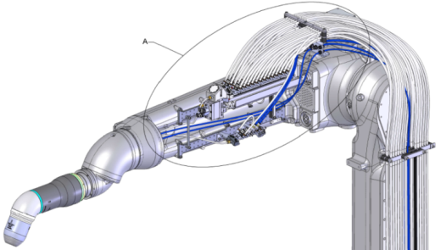
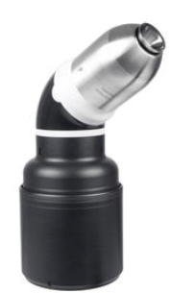
Our product mix in Paintshops Robotic paint atomizer
UPside CCV
Robotic color changer
Gearpumps
2K dedicated
Fast cleaning for Base Coats

Slide 19
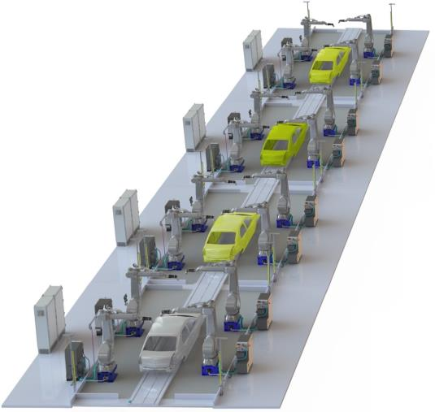
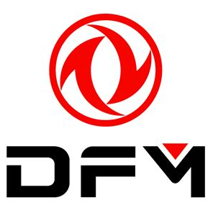
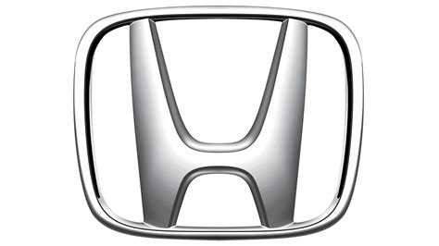
Our Customer mix for Robotic atomizer Direct integration or Integrator partnership

Slide 20
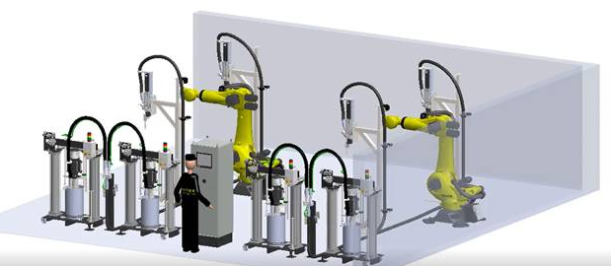
Our Customer mix in Bodyshop
BMW – 600 systems
VW – 670 systems
Porsche – 80 systems
Mercedes – 700 systems
Ford – 60 systems
Stellantis PSA – 130 systems
Stellantis FCA – 100 systems
RENAULT – 100 systems
VOLVO : validated
Notes:
STELLANTIS :
PSA:​
Rennes ~30 systems​
Sevel Nord ~40 systems​
Poissy ~20 systems​
Vigo ~40 systems​
FCA USA: ​
300 gallon Paint Shop PVC Sealer in:​
Warren Truck Assembly Plant ​
Sterling Heights Assembly Plant​
Toledo South Assembly Plant​
Belvidere Assembly Plant​
FCA Italy status: ​
iNTEC SK is validated ​
No installation for now​
Listed in the supplier list
Opel status:​
iNTEC SK is validated but need to be fully validated by STELLANTIS​
No installation for now

Slide 21
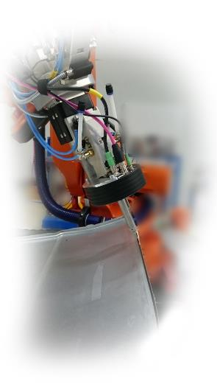
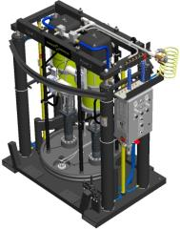
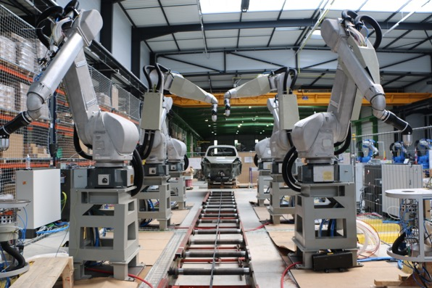
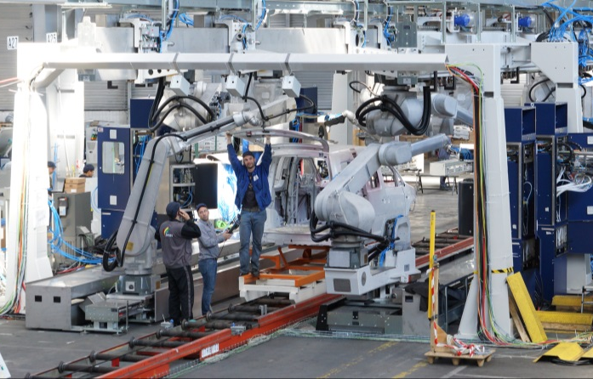
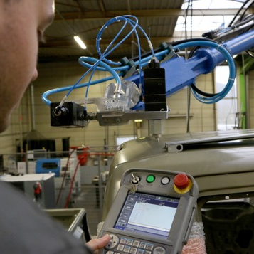
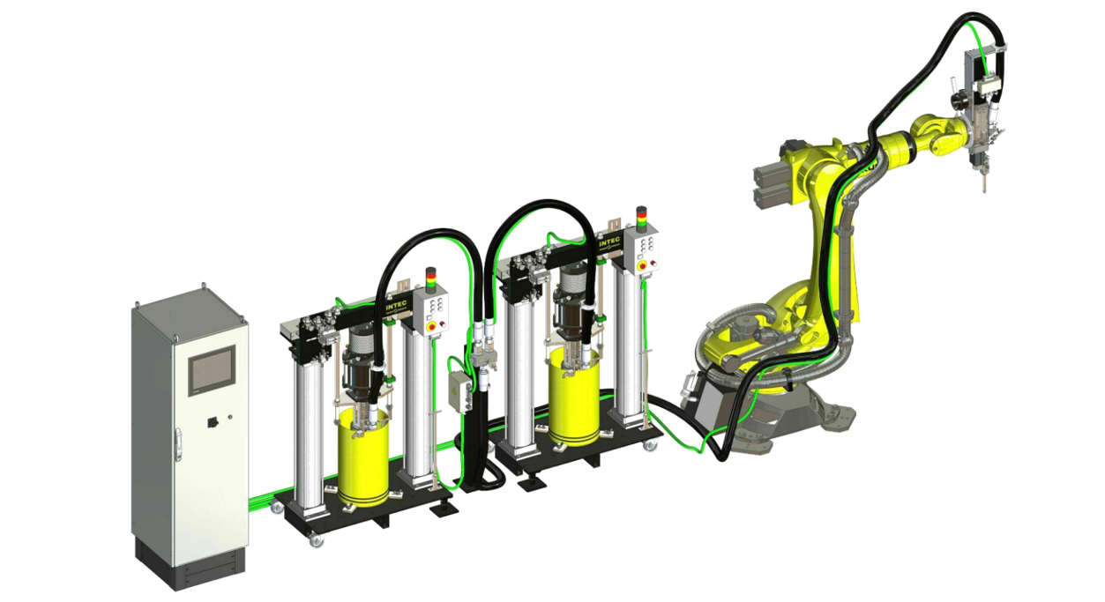
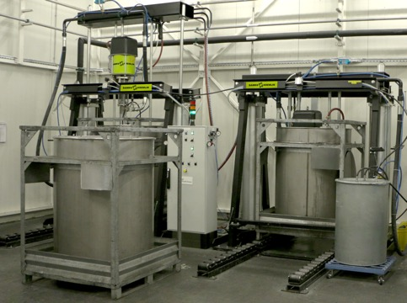
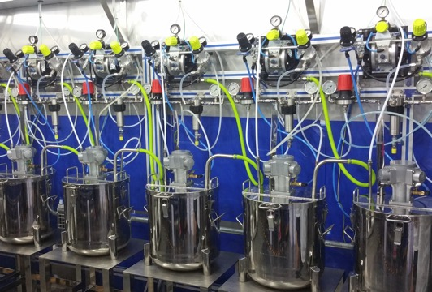
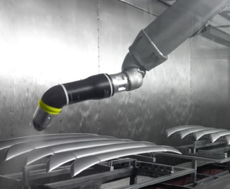
Our Experts at your service Direct or Indirect integration
With our global network of partners we design, manufacture, install and production start up full turn-key solutions for all robotic application or circulating system processes.
Ex : compact robotic booth, continuous conveyor for interior, efficient electrostatic process

Slide 22
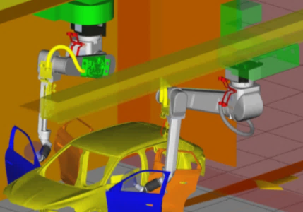
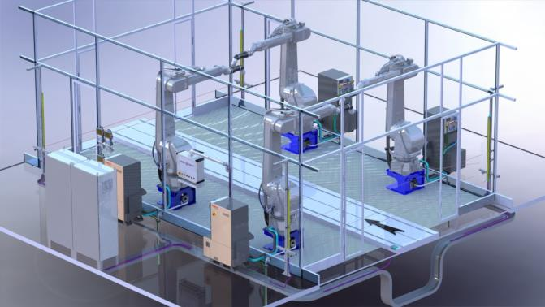
Our Experts at your service Direct integration
Off line programming
12
Mechanical design & layout
22
Modular build
30
Software automation
Application validation lab
Installation & Commissioning
40
25
10

Slide 23
Application Centers Come to validate your process with experts
Sealing & Bonding
Painting
America : Detroit
America : Detroit
Europe : Meylan
Asia : Shanghai
Europe : Meylan
Europe : Stains
Europe : Erftstadt

Slide 25
Sebastien.salze@sames.com

